Slide 1
Intelligent Invoice Processing & Insights: AI-Driven Financial Management
INVISTA DNA TEAM

Slide 2
Agenda
The Challenge: Manual Invoice Processing Pain Points
Key Processing Challenges
Our AI-Driven Solution Architecture
Technical Capabilities & Innovation
Measurable Business Impact

Slide 3

The Challenge: Manual Invoice Processing Pain Points
Today's enterprises are drowning in invoices from global suppliers—often receiving thousands monthly in various languages and formats. This creates significant operational bottlenecks and financial visibility challenges.
High Operational Costs
Payment Delays
Manual data entry requires substantial workforce allocation, with each invoice taking 15-20 minutes to process completely.
Slow processing leads to missed payment deadlines, late fees, and damaged supplier relationships that affect negotiating power.
Data Entry Errors
Poor Financial Visibility
Human processing introduces error rates of 3-5%, creating downstream reconciliation issues and compliance risks.
Fragmented data across systems prevents real-time insights into spending patterns, cash flow projections, and compliance status.
Finance teams struggle particularly with unifying data across currencies, reconciling inconsistent fields from different vendors, and extracting accurate information from unstructured PDFs and scanned documents—creating a perfect storm of inefficiency and missed opportunities.

Slide 4
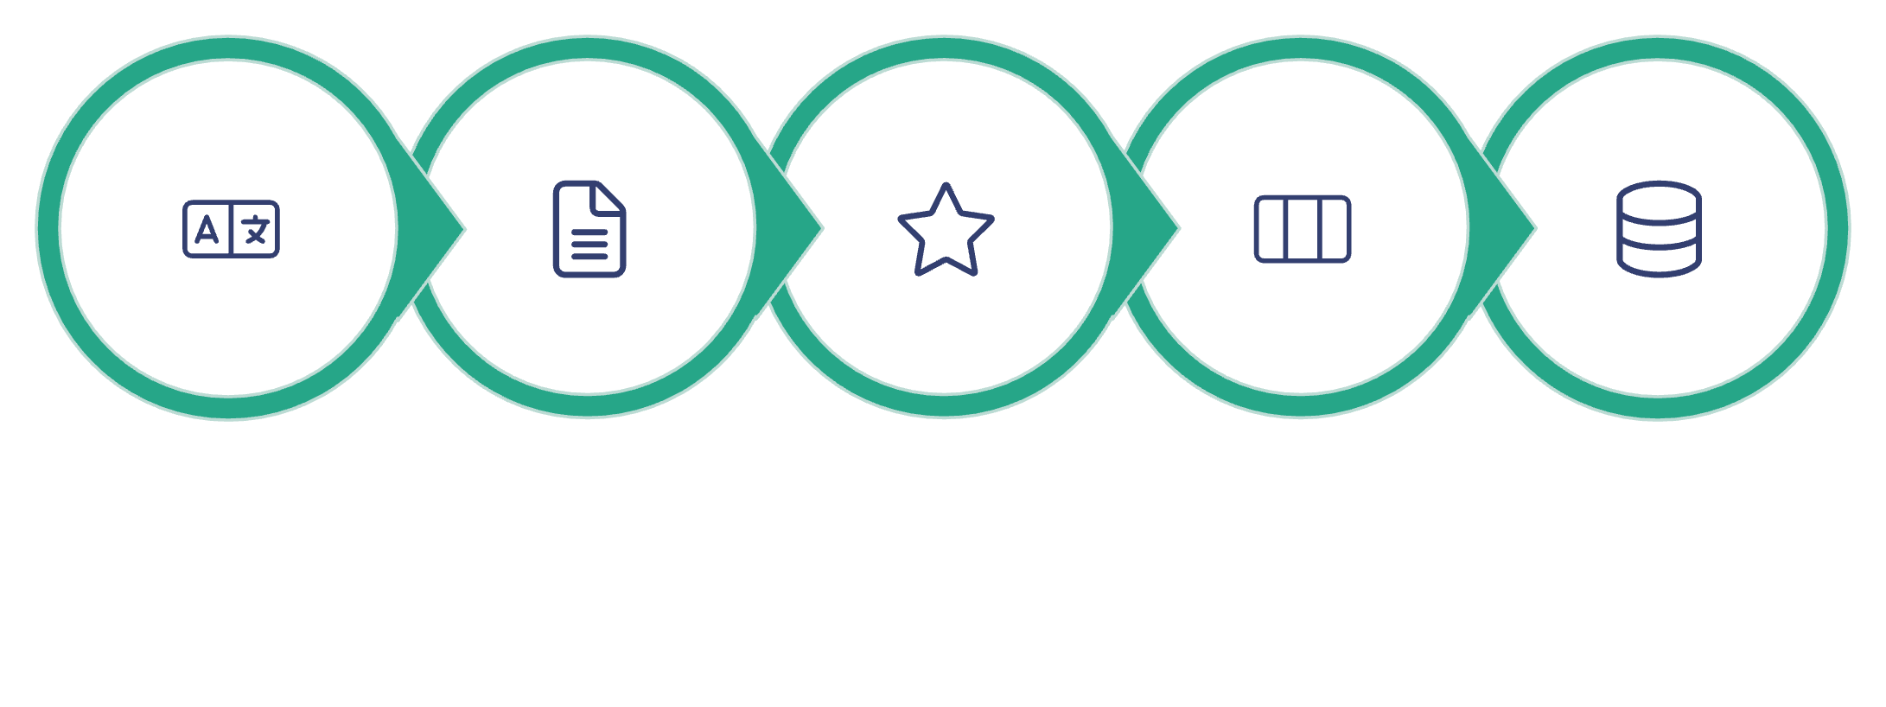





Key Processing Challenges
The complexity of global invoice processing extends beyond simple data entry issues. Modern finance departments face multiple interconnected challenges that significantly impact operations:
These challenges compound as businesses grow:
Each acquisition introduces new invoice formats
Expanding globally adds language complexity
Supplier diversity increases template variations
Regulatory requirements differ by region
Multi-language Invoices
Unstructured Data
Multiple Currencies
Field Variability
Scaling Problems
Currency fluctuations affect financial reporting
Without automation, these challenges create bottlenecks that directly impact cash flow, reporting accuracy, and financial decision-making capabilities across the enterprise.

Slide 5



Our AI-Driven Solution Architecture
We've built a comprehensive system that leverages advanced AI to transform invoice processing from a manual burden into an automated insight engine.
Document AI Engine
Multi-Currency Normalization
Interactive KPI Dashboard
Our proprietary Document AI extracts all relevant fields (amount, dates, tax, line items) from invoices regardless of language, format, or structure—even from poor-quality scans.
Advanced currency detection and conversion automatically standardizes all monetary values to a single reporting currency (typically USD) for consistent analytics.
Real-time visualization of key metrics, spend trends, payment status, and compliance insights through customizable dashboards accessible across devices.
The system includes intelligent quality control that flags exceptions requiring human review while continuously learning from corrections to improve future accuracy. The architecture is built for seamless integration with existing ERPs and financial systems.

Slide 6
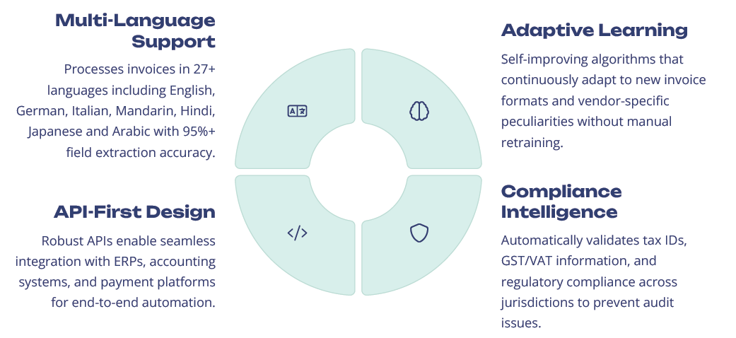
Technical Capabilities & Innovations

Slide 7
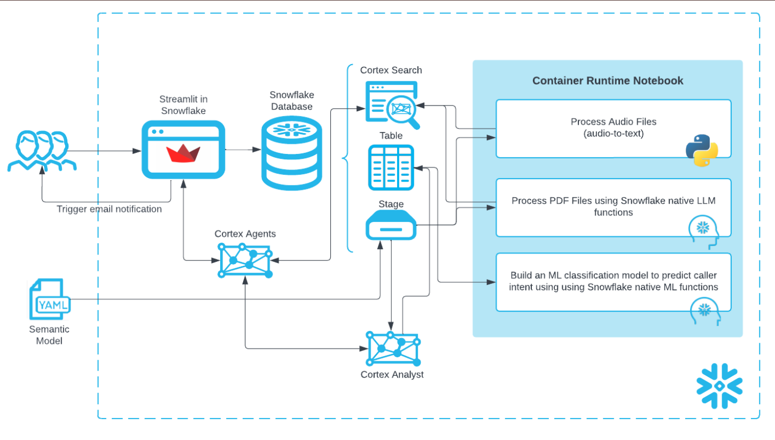
Architecture

Slide 8
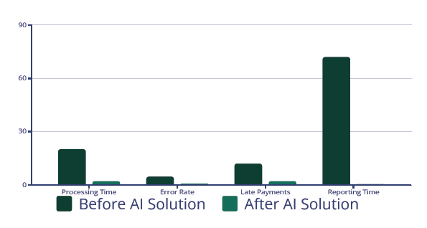
Measurable Business Impact
Reduction in processing time (~90% reduction in minutes
per invoice)
Decrease in data entry errors (~80% decrease )
Fewer late payment incidents (~80% of total)
Faster financial reporting (~99 % faster hours to generate)
** These numbers are estimated based on 200 invoices used in this proof of concept.
** Our estimate is about 30-40% overall cost savings in the account payable operations after implementation, with typical ROI achieved within 4-6 months.

Slide 9
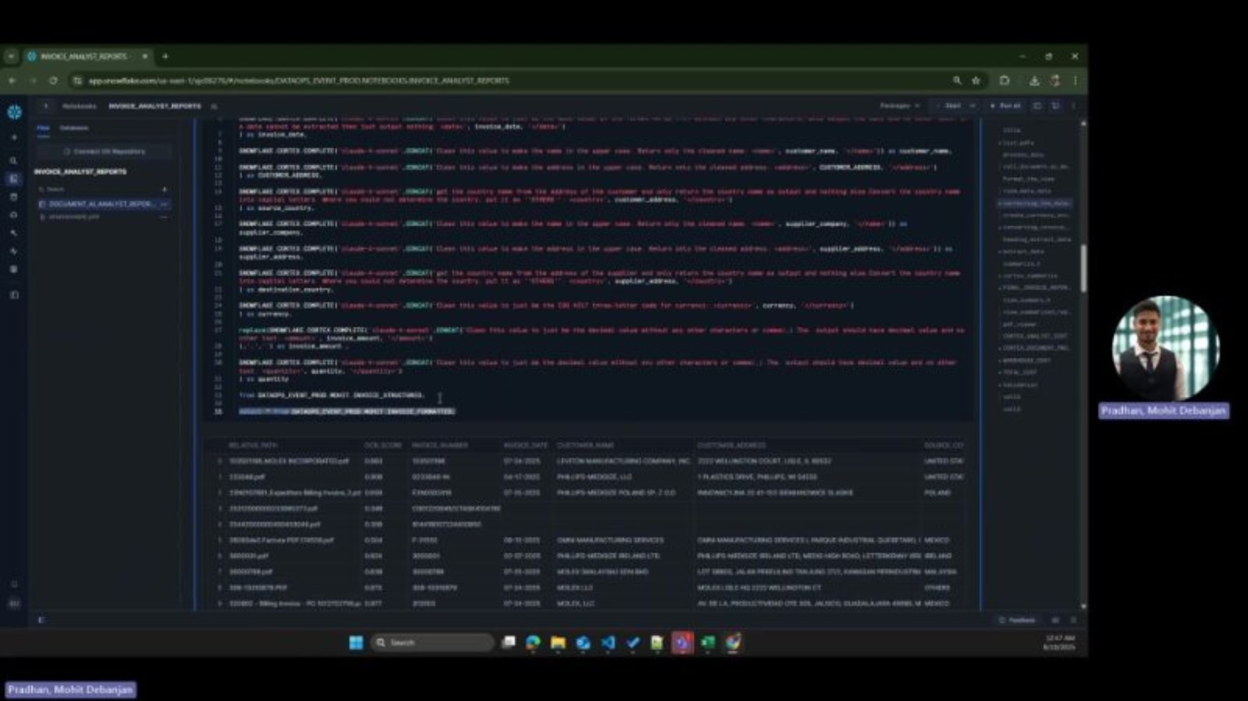
Application Walkthrough (Demo)

Slide 10
THANK YOU

